Slide 1

Quiz Mouse App
Molly McKenzie, Agustin Salas-Vaca, Tekobo Dongmo, Kayode Akinlaja, Kayode Akinlaja

Slide 2
Why Make Quiz Mouse?
Quiz Mouse makes it so users can have a free, simple way to study without being distracted by ads. We made it in a web browser so it could be accessed by anyone with any device.

Slide 3
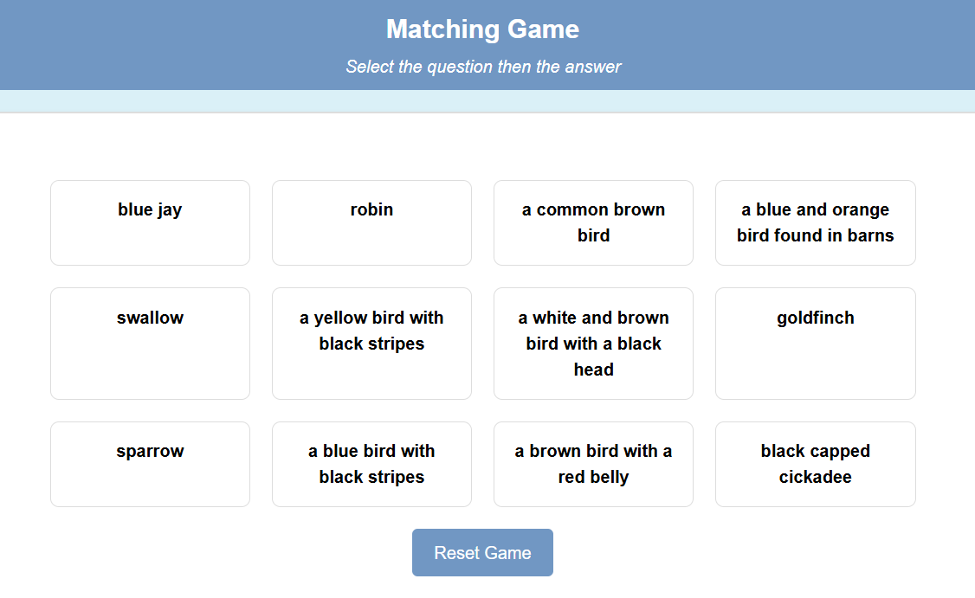
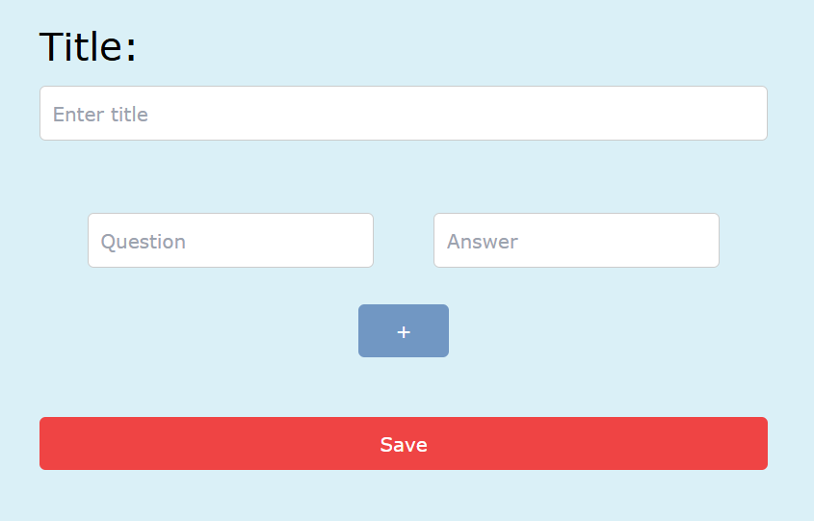
Features of Quiz Mouse
Create Study Set Page
AI groupings on main page
Flashcard Function
Matching Game
Login Page
Signup Page

Slide 4
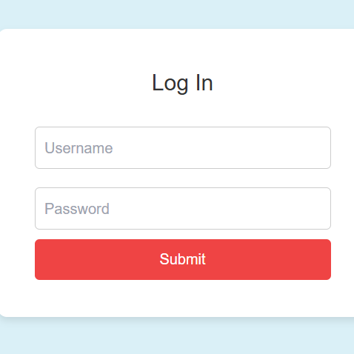
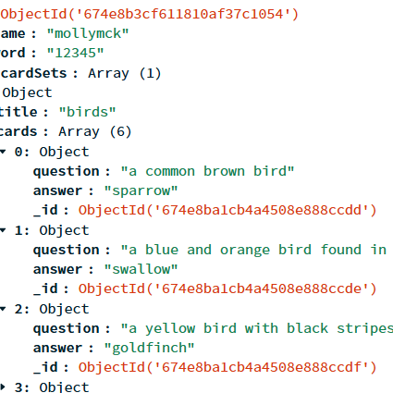
How it Works
MongoDB accesses the study sets associated with the user for the flashcard, matching game and grouping functions
User Logs in and Creates Flashcard Set
User Information + Flashcard Set is Stored in MongoDB

Slide 5

Why Use AI?
One of the best ways to study is by seeing connections between different pieces of material while studying. The AI feature that does this can help the user make new concepts about the material. This method also makes it easier to retain information.

Slide 6
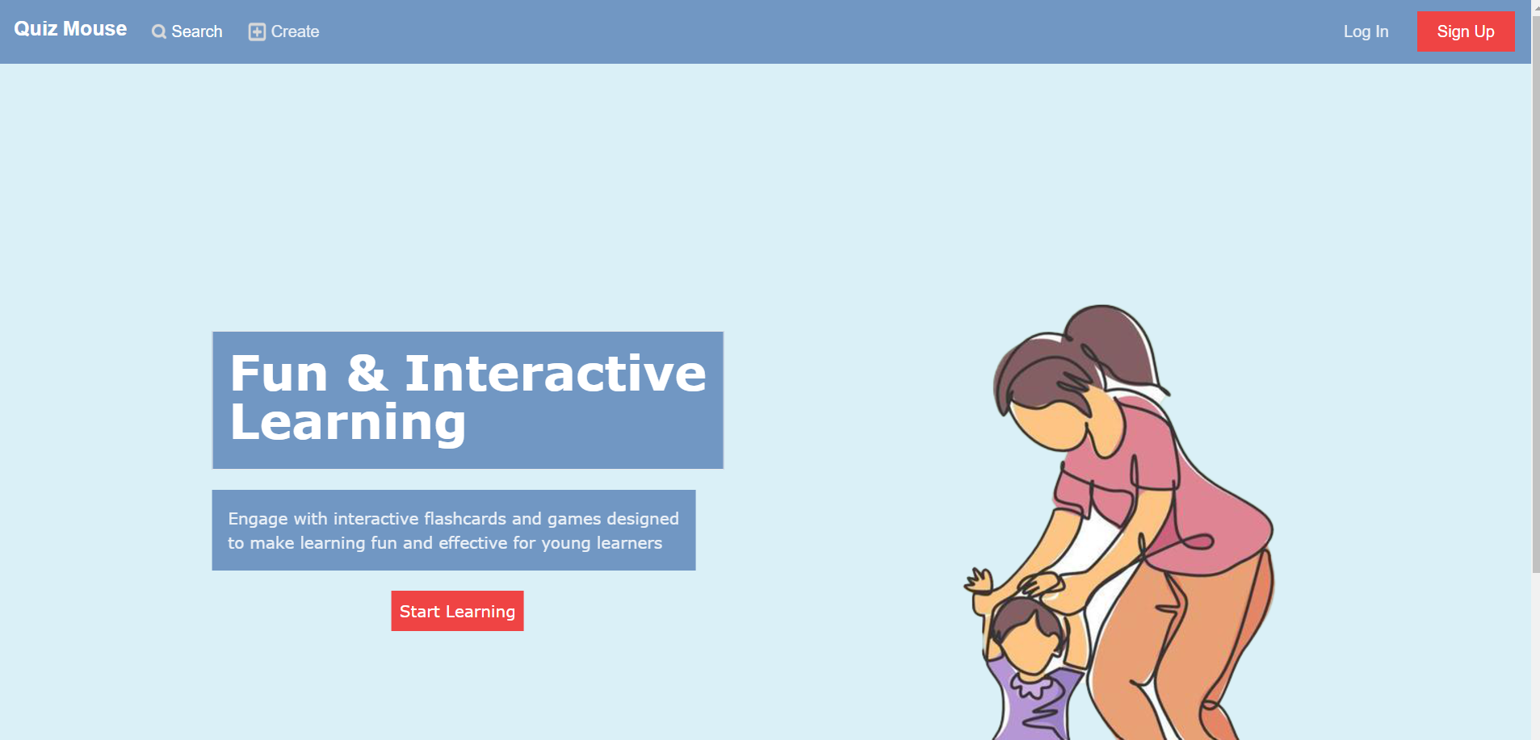
Demo

